Slide 1
ML & DS Workshop

Slide 2
Introduction to AI & ML
Artificial Intelligence:
Artificial intelligence (AI) refers to computer systems capable of performing complex tasks that historically only a human could do, such as reasoning, making decisions, or solving problems.
Machine Learning :
The field of study that gives computers the ability to learn without being explicitly programmed.

Slide 3
Supervised & Unsupervised Machine Learning
Supervised Learning :
It is a form of machine learning in which the algorithm is trained on labeled data to make predictions or decisions based on the data inputs.
Unsupervised Learning :
Unsupervised learning, also known as unsupervised machine learning, uses machine learning algorithms to analyze and cluster unlabeled data sets. These algorithms discover hidden patterns or data groupings without the need for human intervention.

Slide 4
Types of Supervised Machine Learning
Regression:
Regression is a statistical technique that relates a dependent variable to one or more independent variables.
Classification:
Classification is a process of categorizing data or objects into predefined classes or categories based on their features or attributes.

Slide 5
What is Data Science ?
Data Science:
Data science is an interdisciplinary academic field that uses statistics, scientific computing, scientific methods, processes, scientific visualization, algorithms and systems to extract or extrapolate knowledge and insights from potentially noisy, structured, or unstructured data.

Slide 6
Data Science Libraries
Pandas :
It is a software library written for the python programming language for data manipulation and analysis.
Numpy :
NumPy is a library for the Python programming language, adding support for large, multi-dimensional arrays and matrices, along with a large collection of high-level mathematical functions to operate on these arrays.

Slide 7
Data Science Libraries
Matplotlib :
Matplotlib is a plotting library for the Python programming language and its numerical mathematics extension NumPy. It provides an object-oriented API for embedding plots into applications using general-purpose GUI toolkits like Tkinter, wxPython, Qt, or GTK.
Seaborn :
Seaborn is a Python data visualization library based on matplotlib. It provides a high-level interface for drawing attractive and informative statistical graphics.

Slide 8
Data Science Libraries
Warnings :
The Python warnings package is part of the Python standard library and used to alert the user of a problem.
Scikitlearn :
Scikit-learn is a library in Python that provides many unsupervised and supervised learning algorithms.

Slide 9
Underfitting & Overfitting
Underfitting :
Underfitting occurs when a mathematical model cannot adequately capture the underlying structure of the data
Overfitting :
Overfitting in machine learning is when a model becomes too specific to the training data it was trained on, and therefore can't make accurate predictions for new data.

Slide 10
Data Preprocessing Techniques
Feature Scaling :
Scaling is a technique to standardize the independent features present in the data in a fixed range
Standardization
Normalisation

Slide 11
Feature Scaling
Standardization :
Transforms data to have a mean of 0 and a standard deviation of 1
Z = (x-mean)/standard deviation
Standardization can be performed using StandardScalar() function in Scikit learn library

Slide 12
Feature Scaling
Normalization :
Scales data to a fixed range, typically 0 to 1.
Xnorm = (X - Xmax) / (Xmax - Xmin)
Standardization can be performed using MinMaxScalar() function in Scikit learn library

Slide 13
Train-Test Split :
In machine learning, a train-test split is a model validation technique that involves dividing a dataset into two subsets: a training set and a test set. The training set is used to train the model, while the test set is used to evaluate the model's performance and generalization capabilities.

Slide 14


Slide 15
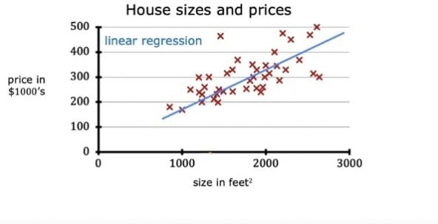
Linear Regression
Linear Regression :
Linear regression is a data analysis technique that predicts the value of unknown data by using another related and known data value(s).
Simple Linear Regression :
y = wx + b

Slide 16
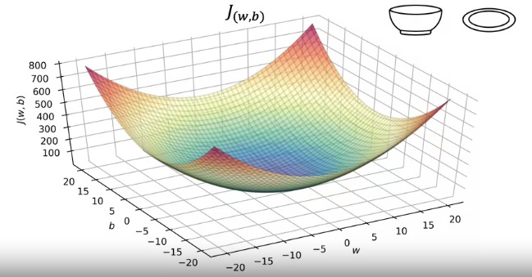
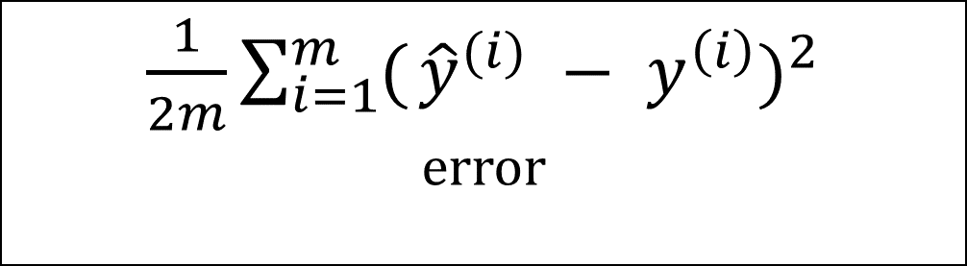
$\frac{1}{2m}\sum_{i=1}^{m}{(}$ ${\hat{y}}^{(i)} − y^{\left(i\right)})^{2}$
error
Cost Function :

Slide 17
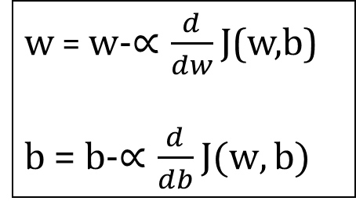
w = w-$∝\frac{d}{dw}$ J(w,b)
b = b-$∝\frac{d}{db}J(w,b)$
Gradient Descent :
Simultaneously
update w and b

Slide 18
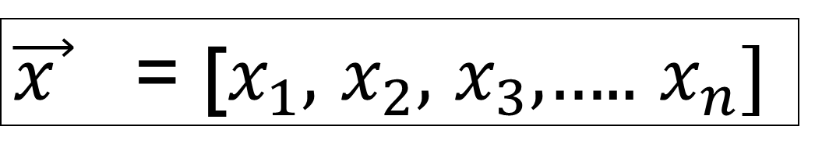
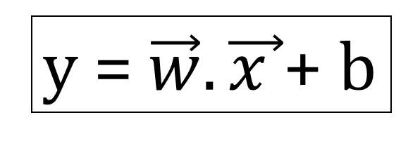
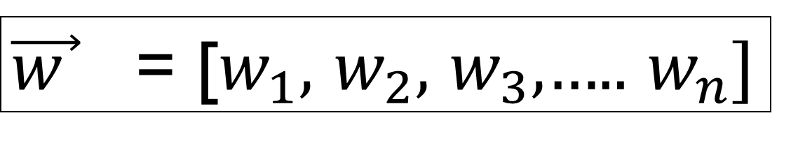
Multiple Linear Regression
y = $\vec{w}.\vec{x }$+ b
$\vec{x }$ = [$x_{1}$, $x_{2}$, $x_{3}$,….. $x_{n}$]
$\vec{w }$ = [$w_{1}$, $w_{2}$, $w_{3}$,….. $w_{n}$]

Slide 19
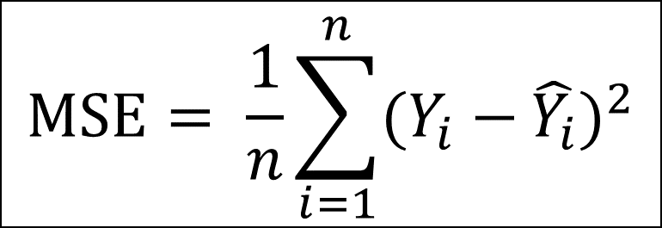
Performance Metrics
Mean Square Error(MSE) :
The MSE measures the average of the squared differences between predicted values and actual target values
$$MSE= \frac{1}{n}\sum_{i=1}^{n}{(Y_{i}−}\hat{Y_{i}})^{2}$$

Slide 20
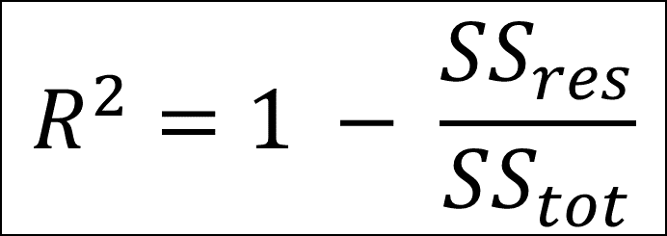
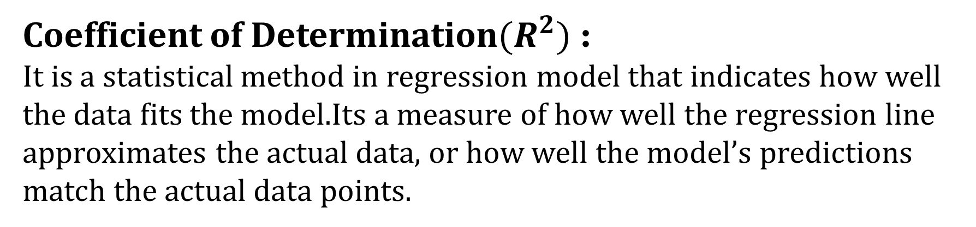
Coefficient of Determination${(R}^{2})$ :
It is a statistical method in regression model that indicates how well the data fits the model.Its a measure of how well the regression line approximates the actual data, or how well the model’s predictions match the actual data points.
$$R^{2}=1 − \frac{SS_{res}}{SS_{tot}}$$

